Slide 1
Introduction to Containerization and Cloud
- Sankara Narayanan

Slide 2


Agenda
Evolution of Digital Era
Key Changes in Software Development Methodologies
Key Changes in Software Delivery and Deployment
Key Changes in Software Architecture
Containers
Demo
Kubernetes
Demo
Kubernetes and Containers in Cloud

Slide 3
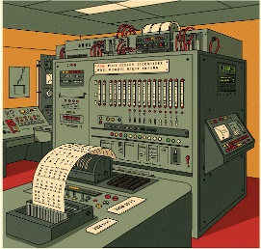
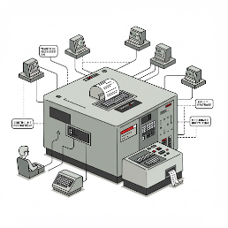
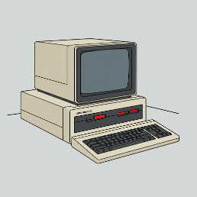
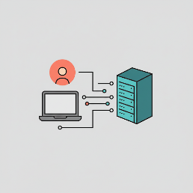
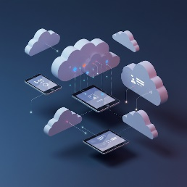
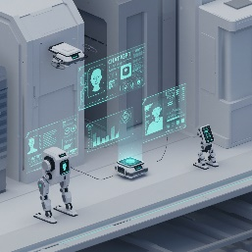
Evolution of Digital Era
Overview
Machine Coding Era (1940’s – 1950’s)
Mainframe Era (1950’s – 1970’s)
Personal Computing Era (1970’s – 1990’s)
Internet and Web Era (1990’s – 2010’s)
Mobile and Cloud Era (2010’s – 2020’s)
Ai and Machine Agent Era (2020’s –)

Slide 4
Evolution of Digital Era
Trend
Digital Literacy is increasing
Our Digital Footprint keeps on increasing
Software systems are getting more complex and sophisticated
New technologies, opportunities and challenges are coming in a fast pace
There is a time pressure to capture the opportunities

Slide 5
Key Changes in Software Development Methodologies
Waterfall - Legacy
With the introduction of structured programming (oops) a well defined process of creating software emerged.
Requirements are well documented and finalized before implementation phase
Led to Long release cycles with new requirements disrupting the development flow
Is suited for stable slow moving world
Analyze
Plan
Develop
Test
Deploy
Design

Slide 6
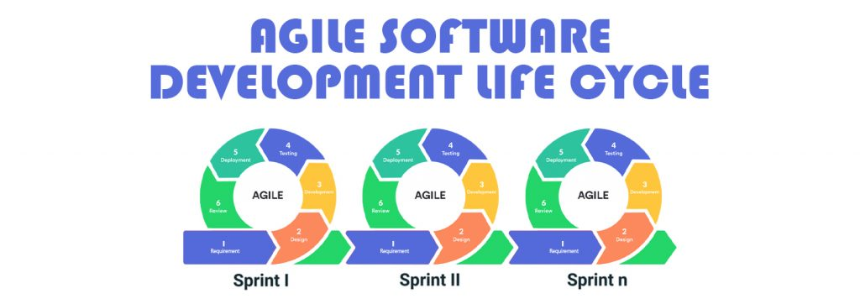
Key Changes in Software Development Methodologies
Agile Methodologies - Current
https://agilemanifesto.org/principles.html
Encourages continuous feedback, adaptability, and delivering small, functional increments of software rather than a single large release
Work is divided into short cycles called iterations (or sprints). Functional parts of the software are delivered frequently (every few weeks).
Regular feedback is integrated into the development process. Requirements and priorities evolve based on feedback.
Developers, testers, designers, and business stakeholders work closely together. Teams reflect on their work and adjust their processes regularly (e.g., through retrospectives).

Slide 7
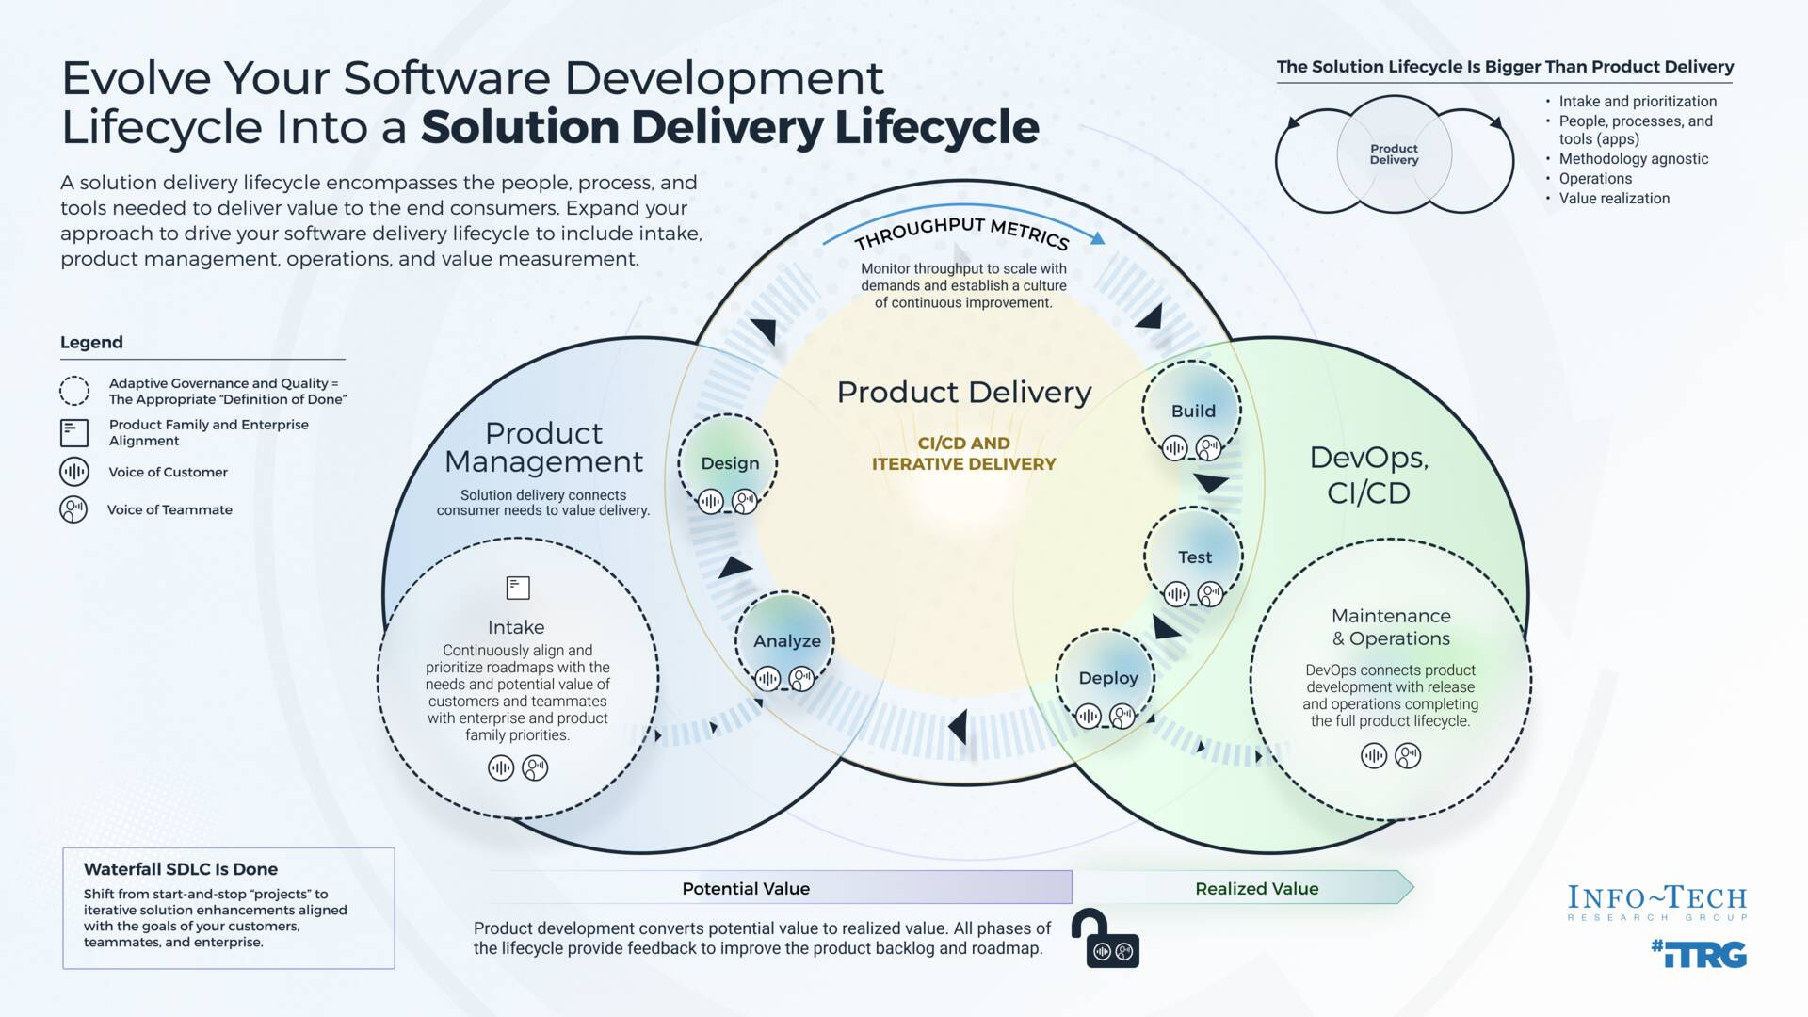
Key Changes in Software Development Methodologies
Devops – Development and Operation
DevOps is a culture, methodology, and set of practices that automates the software build, deployment, testing and release
Code Review
Continuous Integration
Continuous Testing
Frequent Releases
Is needed to ensure quality in fast evolving world
Evolved to MLOps and GitOps to handle emerging challenges
Reference: https://www.infotech.com/research/ss/evolve-your-software-development-lifecycle-into-a-solution-delivery-lifecycle

Slide 8
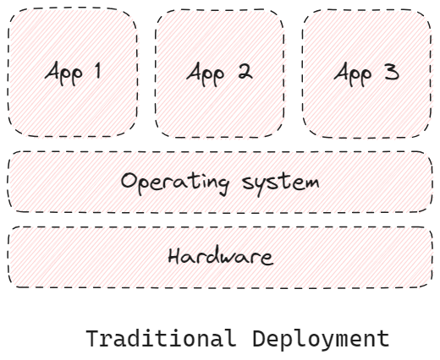
Key Changes in Software Delivery & Deployment
Traditional Deployment
In Traditional Deployment model, the app runs directly on a physical machine.
The cpu, memory and io devices are accessed directly through system calls.
No Additional Resource Overhead.
Suitable for latency sensitive applications

Slide 9
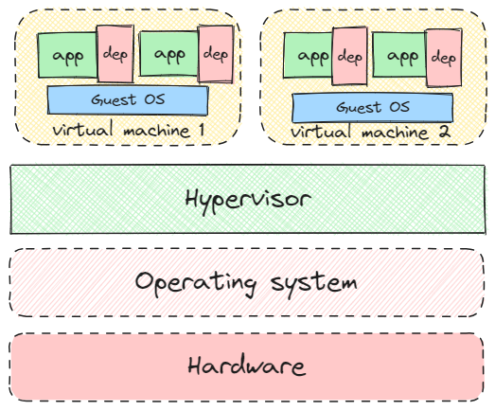
Key Changes in Software Delivery & Deployment
Virtualized Deployment
A Virtual Machine (VM) is a software-based emulation of a physical computer that runs an operating system (OS) and applications just like a physical machine. It operates using virtualization technology, allowing multiple VMs to run on a single physical server
Hypervisor is the software that creates and manages VMs (e.g., VMware, Microsoft Hyper-V, KVM).
Resource isolation
App Code > Guest OS > Virtualization Layer > Host OS
Traditionally, An overhead of 10 – 25 % is introduced due to additional layers.

Slide 10
Key Changes in Software Delivery & Deployment
Why Virtual Machine ?
Virtual Machine Technology itself is available from 1970’s onwards. When resource is scarce a single mainframe need to be shared by many process.
First commercial VM system (1972), allowing multiple guest OS instances on IBM mainframes
1980s saw a decline of Virtual Machines with the rise of PCs
With the emergence of Centralized Datacenters and cloud, virtualization re-emerged as a key technology enabling cloud machines. New Virtualization technologies are optimized to reduce the overhead under 3 %

Slide 11
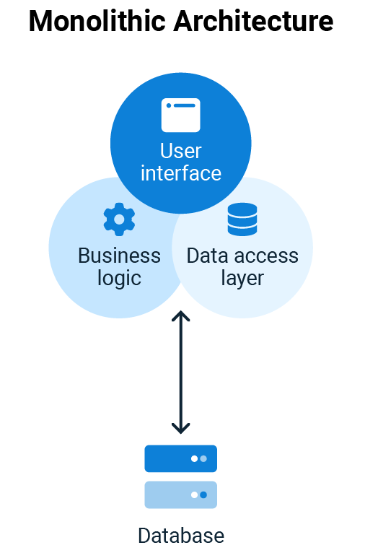
Key Changes in Software Architecture
Monolith – Legacy
Monolith Application runs as a single process
All modules / functionalities is served by the same process
Usually served by a dedicated server
Api calls are direct function calls
The entire application should follow the same tech stack and code base
Delivery is a Single set of binary

Slide 12
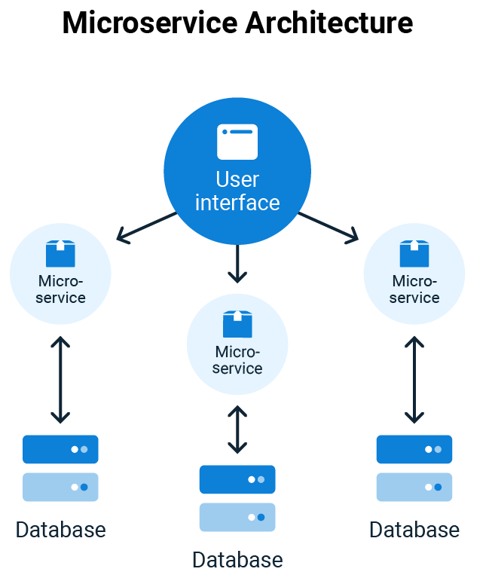
Key Changes in Software Architecture
Microservices – Current
Microservices is an architectural style where an application is built as a collection of small, independent services that communicate via APIs.
Each service is designed to perform a specific function and can be developed, deployed, and scaled independently (ex. web assets, catalog service, order service, discount service, recommendation service, messaging service)
Usually delivered as containers and served by an embedded server
Api calls are made over network
Different application can have different tech stack and code base
Usually Delivered as set of containers and helm charts

Slide 13
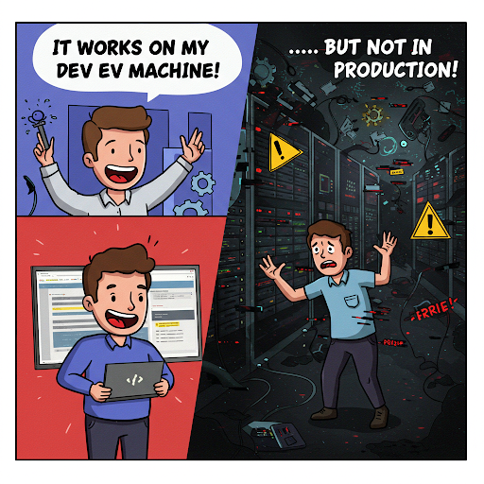
Containers
Platform and Dependencies issues
Microservices Architecture approach led to the split of single app to multiple services.
Multiple services led to complexity in managing dependencies and platform environments
This led to additional complexities in production environments especially when there are multiple services developed by separate teams.
Issues
Version Mismatch between dev and production environments
Conflicting dependencies
Production should follow the same environment as dev
Single tech stack is not suited to solve all diverse computational problem (ex. Machine learning)

Slide 14

Containers
Introduction
A container is a lightweight, portable, and isolated binary image that packages an application and all its dependencies (libraries, binaries, and configuration files) so that it runs consistently across different computing environments.
Containers can run on any operating system, including Linux, Windows, and Mac, and in any environment, including virtual machines, bare metal, and the public cloud
Containers share the OS kernel, making them more lightweight than virtual machines (VMs)
Containers provides resource isolation. We could provide upper resource (cpu, memory) limit for specific containers, which gives us more control in scheduling

Slide 15
Containers
Technical Concepts
Container Image
Containers
Containers are running instance of Container image. A process which runs when executing a container image. Multiple instance of process can be tarted from one container image
Container Runtime
A container runtime is the software responsible which executes the container image and create containers It ensures the lifecycle of containers. There are different container runtimes. Ex. podman, docker engine containerd, CRI-O
Container Registry
Container Tag
A container image is a executable package that contains everything needed to run an application consistently across different environments. It is a software package.
A container registry is a central software repository hub which stores container images. Central public container registries are https://hub.docker.com/, google public cloud storage etc..
Container Tag is the version which distinguish different container image versions. It is similar to software version.

Slide 16
Containers
Docker
Docker is an open-source platform that allows developers to build, package, and run applications in containers.
Before Docker, containers were complex and mainly used by system administrators. Docker simplified containerization and made it mainstream by providing a developer-friendly, portable, and standardized solution.
Docker Engine – The core container runtime that runs and manages containers.
Docker Hub / Registry – A cloud-based service to store and share container images.
Docker images – A container image as packaged by docker
Docker Compose – A tool for defining and running multi-container applications (docker-compose.yml).
Docker CLI – Command-line interface for managing containers (docker run, docker ps).
Dockerfile – A file which has instructions on how to build docker image

Slide 17
Containers Demo

Slide 18
Kubernetes
Need for Container Orchestration platform
Increased Complexity in Orchestration
Running multiple containers required manual deployment, scaling, and monitoring. Scaling containers up/down manually was slow and inefficient. If a container crashed, manual intervention was needed to restart it.
Monitoring and Observability Overload
Tracking performance and health of numerous containers becomes overwhelming.
Networking Complexity
Managing internal/external traffic across multiple containers.
Difficulties in inter-container communication and service discovery.
Resource Allocation and Optimization
Efficiently managing CPU, memory, and other resources across containers.
Risk of resource contention, underutilization, or overprovisioning

Slide 19
Kubernetes
Overview
Kubernetes (K8s) is an open-source container orchestration platform that automates the deployment, scaling, and management of containerized applications. It is originally developed by Google, now maintained by the Cloud Native Computing Foundation (CNCF).
Automated Deployment & Scaling – Manages containerized apps without manual intervention.
Self-Healing – Restarts failed containers and replaces unhealthy ones.
Load Balancing & Service Discovery – Distributes traffic and ensures stable networking.
Multi-Cloud & Hybrid Support – Works on on-prem, AWS, GCP, Azure, and more.
Rolling Updates & Rollbacks – Deploy updates without downtime.
Features of Kubernetes
Declarative container orchestration
Storage Automation
Service Discovery & Load Balancing
Rolling Updates and Rollbacks
Multi Cloud & On Prem Support
Auto Scale Features

Slide 20
Kubernetes
Technical Concepts
Node
Cluster
A Kubernetes cluster is a set of nodes that work together to run and manage containerized applications. It consists of worker nodes (where applications run) and a control plane (which manages the cluster).
Pods
A Pod is the smallest deployable unit in Kubernetes. It represents one or more containers that share storage, networking, and configuration.
Control Plane
Deployment
A Kubernetes Node is a worker machine (virtual or physical) where containers run. Nodes are managed by the Kubernetes Control Plane and are responsible for running Pods.
The Kubernetes Control Plane is the brain of the cluster. It manages and orchestrates all cluster operations, ensuring workloads run efficiently on worker nodes.
A Kubernetes Deployment is a higher-level abstraction that manages and automates the lifecycle of Pods. It ensures the correct number of replicas are running, supports rolling updates, and provides self-healing capabilities.

Slide 21
Kubernetes
Technical Concepts
Job
Secret
A Kubernetes Secret is an object used to store sensitive data, such as passwords, API keys, and certificates, securely. Secrets can be mounted to containers which can be used by the process
Config Map
A Kubernetes ConfigMap is an object used to store non-sensitive configuration data in key-value pairs. It allows separating configuration from application code, making deployments more flexible and manageable. It can be mounted as files to a container
Service
Ingress
A Kubernetes Job is a workload resource that runs a task once (or a fixed number of times) and ensures it completes successfully. Unlike Deployments, which manage long-running applications, Jobs are used for short-lived, batch processing tasks. There is special kind of workload in k8s called cron-job which runs at scheduled interval
A Kubernetes Service is an abstraction that exposes a group of Pods and provides a stable network endpoint for communication. Since Pods are restart and can be replaced, a Service ensures consistent access to them.
Ingress is a Kubernetes API object that manages external access to services inside a cluster, typically using HTTP(S). It acts as a reverse proxy and load balancer, allowing users to define rules for routing external traffic to internal services.

Slide 22
Kubernetes
Technical Concepts
Persistent volume
Horizontal Pod Autoscaler (HPA)
Horizontal Pod Autoscaler (HPA) is a Kubernetes feature that automatically scales the number of Pod replicas in a Deployment, StatefulSet, or ReplicaSet based on CPU, memory, or custom metrics.
Cluster Auto Scaler
Cluster Autoscaler (CA) is a Kubernetes component that automatically scales the number of worker nodes in a cluster based on workload demands. It ensures that, New nodes are added when Pods can’t be scheduled due to insufficient resources and Idle nodes are removed when they are no longer needed.
Service Account
A Persistent Volume (PV) is a storage abstraction in Kubernetes that provides persistent, cluster-wide storage for Pods. Unlike regular container storage (which is temporary), PVs retain data even if Pods restart or get deleted.
A Service Account in Kubernetes is an identity used by Pods to interact with the Kubernetes API. It grants permissions to Pods for accessing resources, such as secrets, ConfigMaps, or other Kubernetes objects.

Slide 23
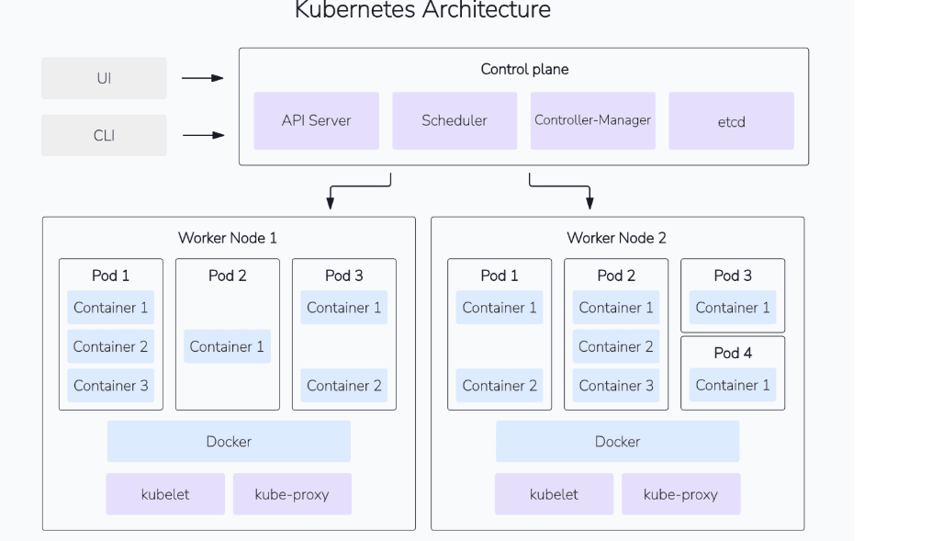
Kubernetes
Architecture

Slide 24
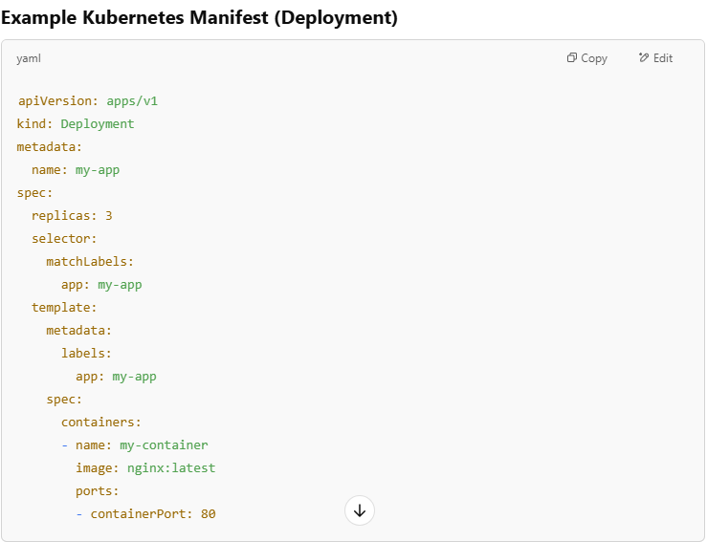
Kubernetes
Manifest
A Kubernetes manifest is a YAML or JSON file that defines the desired state of a Kubernetes resource (e.g., Pods, Deployments, Services). It tells Kubernetes what to create, update, or delete in the cluster.

Slide 25
Kubernetes Demo

Slide 26
